Slide 1
Lecture 2:
Image Classification pipeline

Slide 2
Administrative
First assignment will come out tonight (or tomorrow at worst)
It is due January 20 (i.e. in two weeks). Handed in through CourseWork
It includes:
Write/train/evaluate a kNN classifier
Write/train/evaluate a Linear Classifier (SVM and Softmax)
Write/train/evaluate a 2-layer Neural Network (backpropagation!)
Requires writing numpy/Python code
Warning: don’t work on assignments from last year!
Compute: Can use your own laptops, or Terminal.com

Slide 3

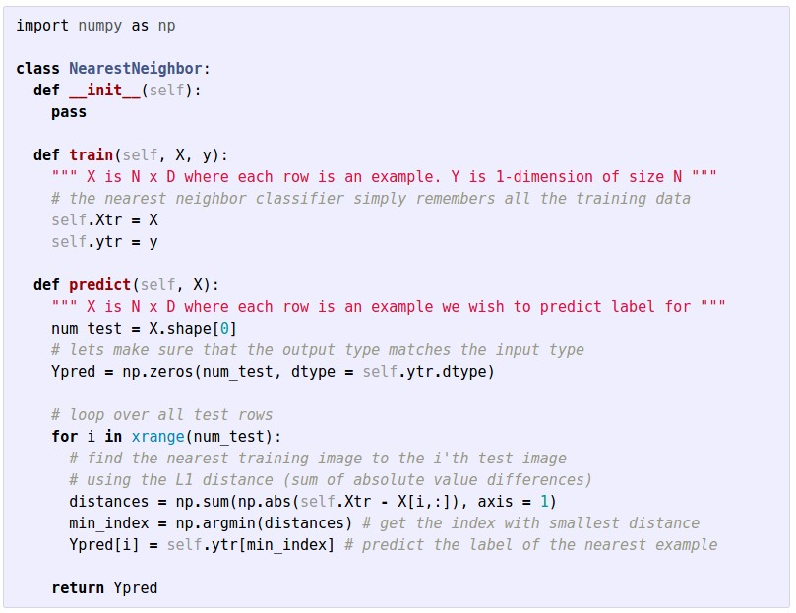
http://cs231n.github.io/python-numpy-tutorial/

Slide 4
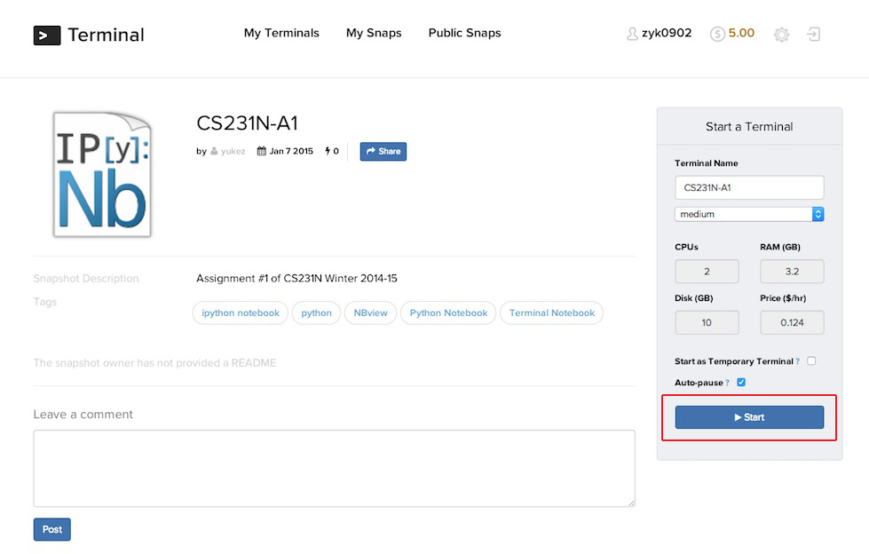

Slide 5
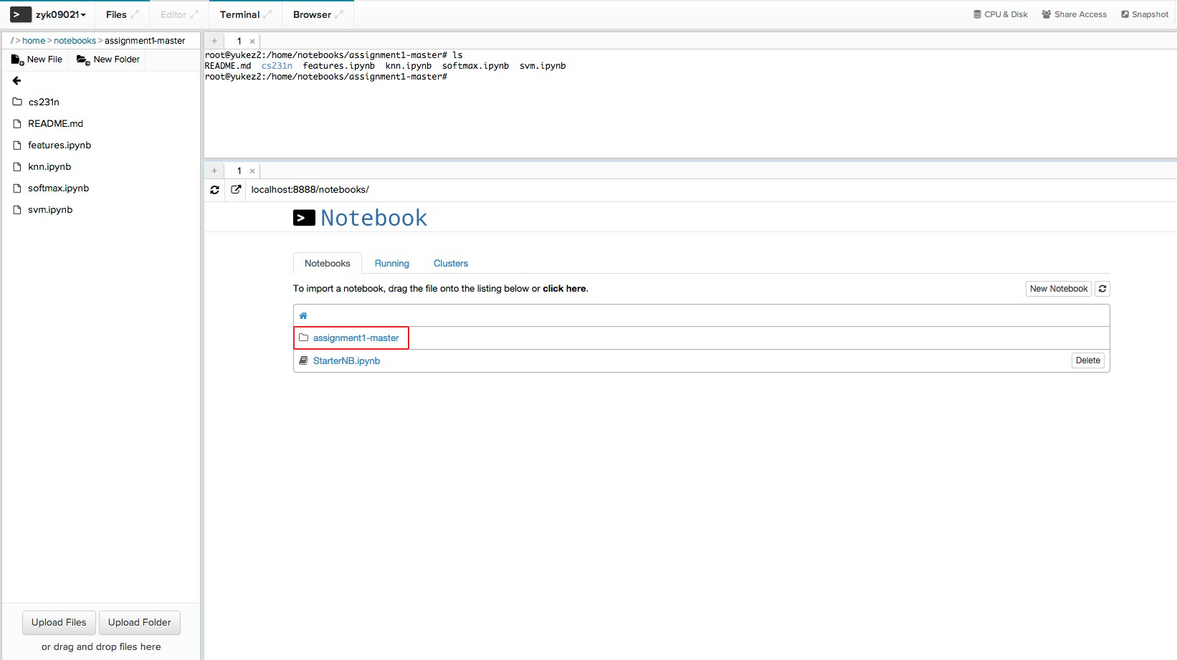

Slide 6
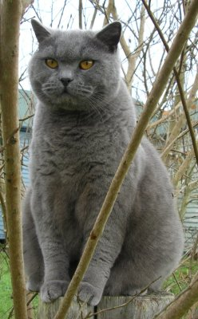
Image Classification: a core task in Computer Vision
(assume given set of discrete labels)
{dog, cat, truck, plane, ...}
cat

Slide 7

The problem:
semantic gap
Images are represented as 3D arrays of numbers, with integers between [0, 255].
E.g.
300 x 100 x 3
(3 for 3 color channels RGB)

Slide 8
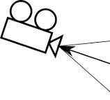
Challenges: Viewpoint Variation

Slide 9
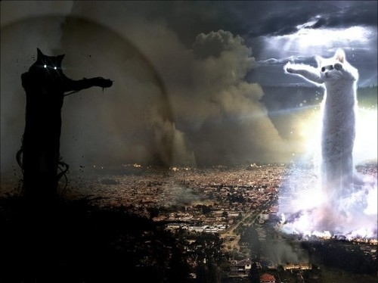
Challenges: Illumination

Slide 10

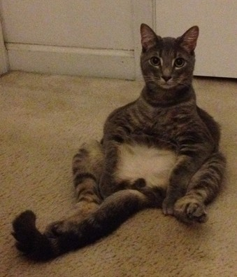
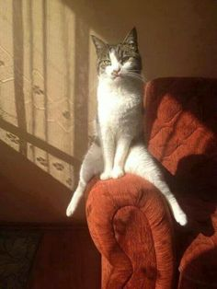
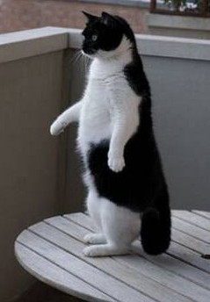
Challenges: Deformation

Slide 11
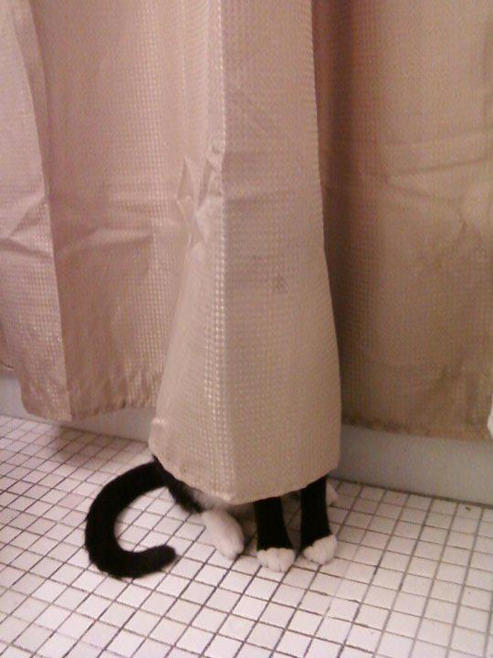
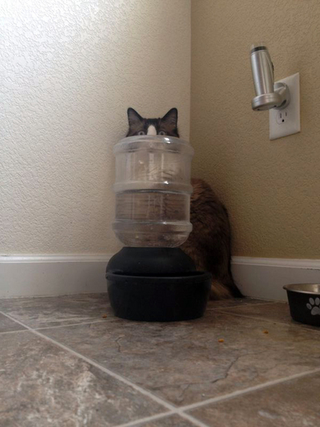
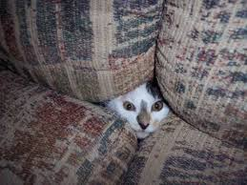
Challenges: Occlusion

Slide 12
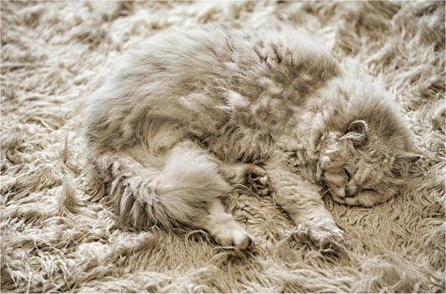
Challenges: Background clutter

Slide 13
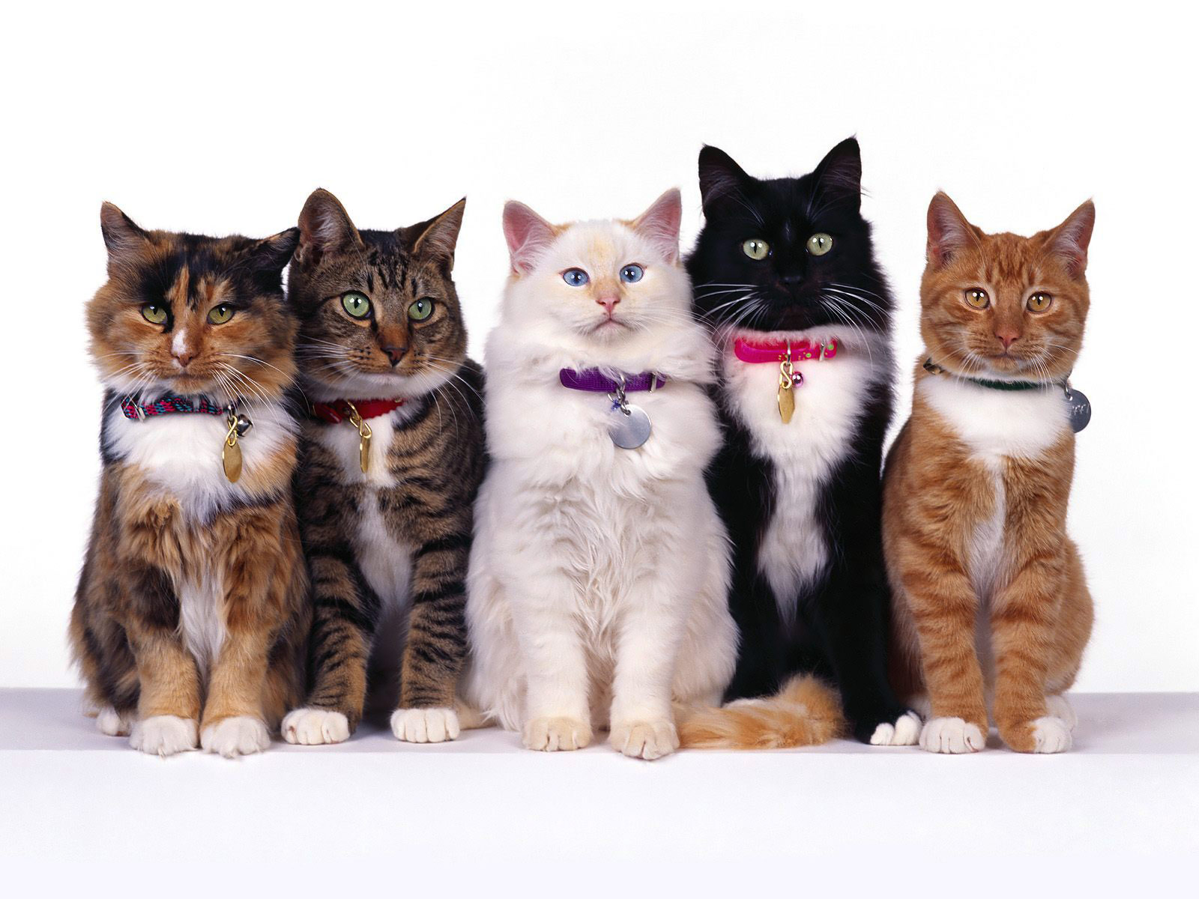
Challenges: Intraclass variation

Slide 14
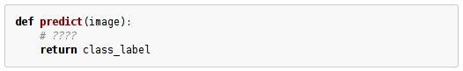
An image classifier
Unlike e.g. sorting a list of numbers,
no obvious way to hard-code the algorithm for recognizing a cat, or other classes.

Slide 15
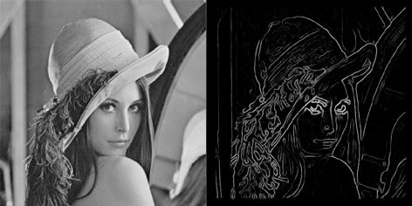
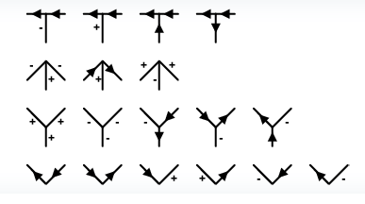
Attempts have been made
???

Slide 16
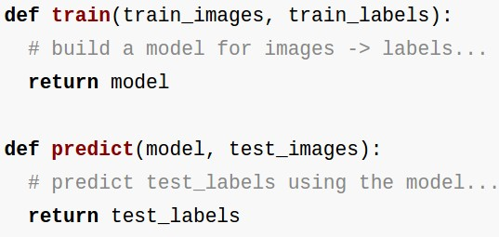
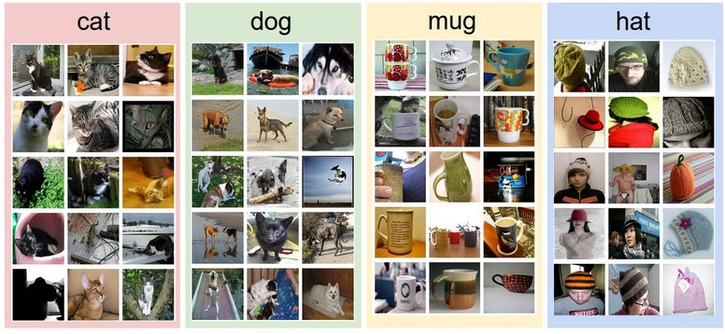
Data-driven approach:
Collect a dataset of images and labels
Use Machine Learning to train an image classifier
Evaluate the classifier on a withheld set of test images
Example training set

Slide 17
First classifier: Nearest Neighbor Classifier
Remember all training images and their labels
Predict the label of the most similar training image

Slide 18
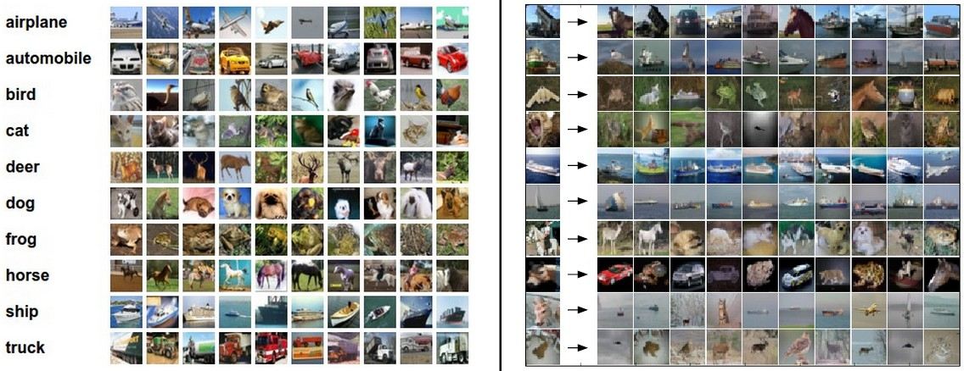
Example dataset: CIFAR-10
10 labels
50,000 training images, each image is tiny: 32x32
10,000 test images.

Slide 19
Example dataset: CIFAR-10
10 labels
50,000 training images
10,000 test images.
For every test image (first column), examples of nearest neighbors in rows

Slide 20
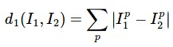
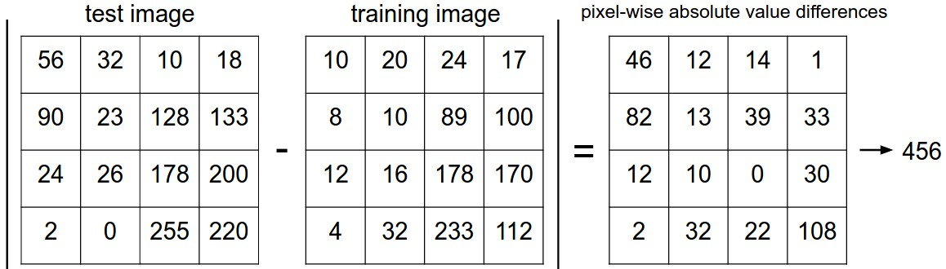
How do we compare the images? What is the distance metric?
L1 distance:
add

Slide 21
Nearest Neighbor classifier

Slide 22
Nearest Neighbor classifier
remember the training data

Slide 23
Nearest Neighbor classifier
for every test image:
find nearest train image with L1 distance
predict the label of nearest training image

Slide 24
Nearest Neighbor classifier
Q: how does the classification speed depend on the size of the training data?

Slide 25
Nearest Neighbor classifier
Q: how does the classification speed depend on the size of the training data? linearly :(
This is backwards:
- test time performance is usually much more important in practice.
- CNNs flip this: expensive training, cheap test evaluation

Slide 26
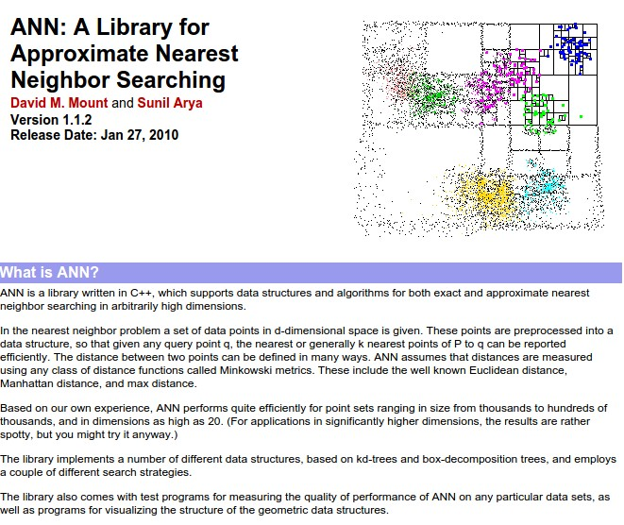
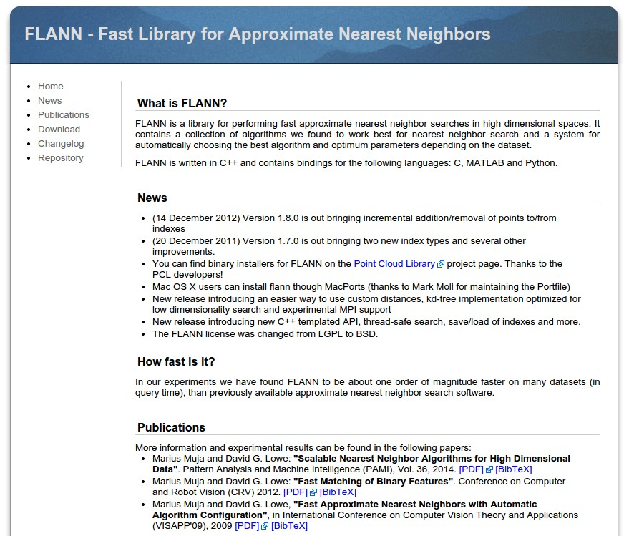
Aside: Approximate Nearest Neighbor
find approximate nearest neighbors quickly

Slide 27
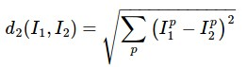
The choice of distance is a hyperparameter
common choices:
L1 (Manhattan) distance
L2 (Euclidean) distance

Slide 28
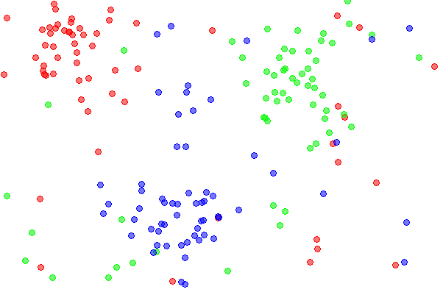
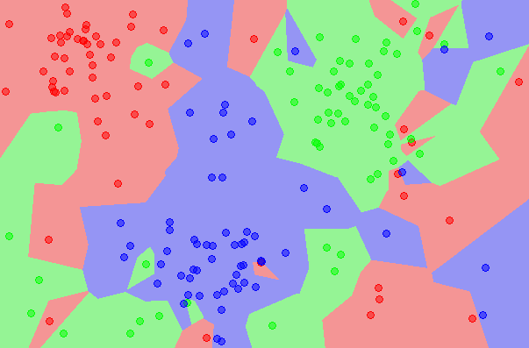
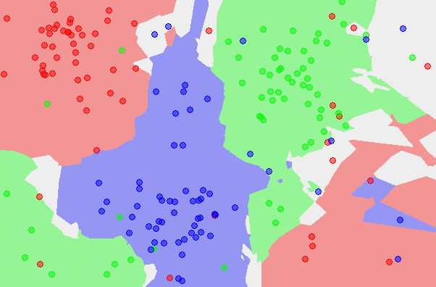
k-Nearest Neighbor
find the k nearest images, have them vote on the label
the data
NN classifier
5-NN classifier
http://en.wikipedia.org/wiki/K-nearest_neighbors_algorithm

Slide 29
Example dataset: CIFAR-10
10 labels
50,000 training images
10,000 test images.
For every test image (first column), examples of nearest neighbors in rows

Slide 30
the data
NN classifier
5-NN classifier
Q: what is the accuracy of the nearest neighbor classifier on the training data, when using the Euclidean distance?

Slide 31
the data
NN classifier
5-NN classifier
Q2: what is the accuracy of the k-nearest neighbor classifier on the training data?

Slide 32
What is the best distance to use?
What is the best value of k to use?
i.e. how do we set the hyperparameters?

Slide 33
What is the best distance to use?
What is the best value of k to use?
i.e. how do we set the hyperparameters?
Very problem-dependent.
Must try them all out and see what works best.

Slide 34
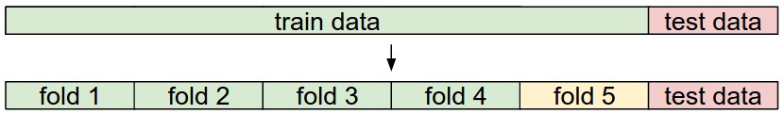
Try out what hyperparameters work best on test set.

Slide 35
Trying out what hyperparameters work best on test set:
Very bad idea. The test set is a proxy for the generalization performance!
Use only VERY SPARINGLY, at the end.

Slide 36
Validation data
use to tune hyperparameters

Slide 37
Cross-validation
cycle through the choice of which fold is the validation fold, average results.

Slide 38
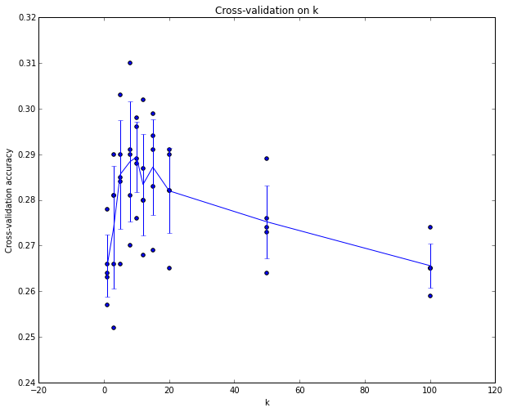
Example of
5-fold cross-validation
for the value of k.
Each point: single
outcome.
The line goes
through the mean, bars
indicated standard
deviation
(Seems that k ~= 7 works best
for this data)

Slide 39
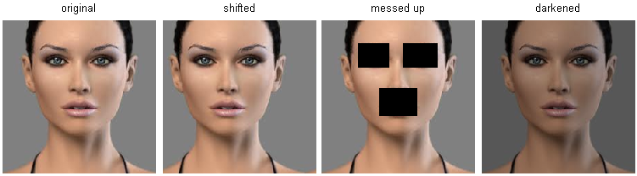
k-Nearest Neighbor on images never used.
terrible performance at test time
distance metrics on level of whole images can be very unintuitive
(all 3 images have same L2 distance to the one on the left)

Slide 40
Summary
Image Classification: We are given a Training Set of labeled images, asked to predict labels on Test Set. Common to report the Accuracy of predictions (fraction of correctly predicted images)
We introduced the k-Nearest Neighbor Classifier, which predicts the labels based on nearest images in the training set
We saw that the choice of distance and the value of k are hyperparameters that are tuned using a validation set, or through cross-validation if the size of the data is small.
Once the best set of hyperparameters is chosen, the classifier is evaluated once on the test set, and reported as the performance of kNN on that data.

Slide 41
Linear Classification

Slide 42
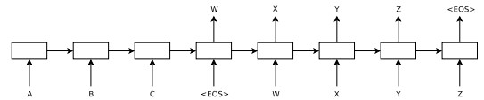
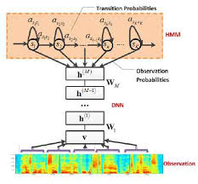
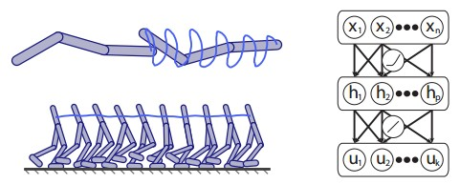

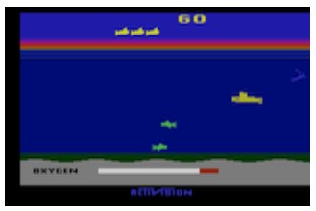
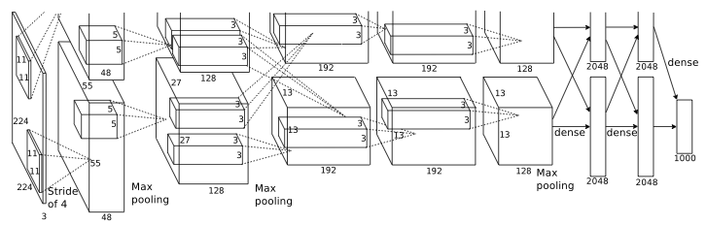
language
control
think
hear
see

Slide 43

Neural Networks practitioner

Slide 44
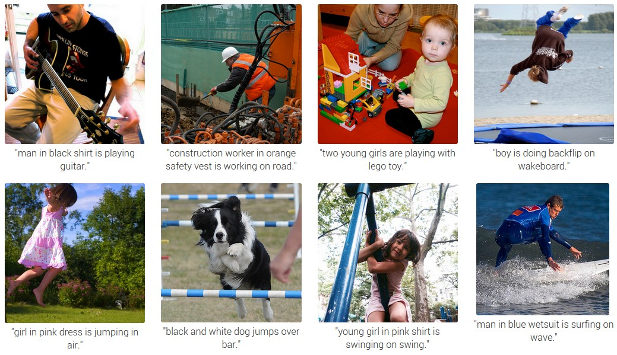

Slide 45
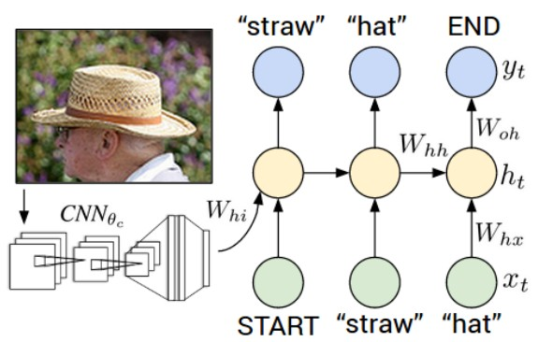
RNN
CNN

Slide 46
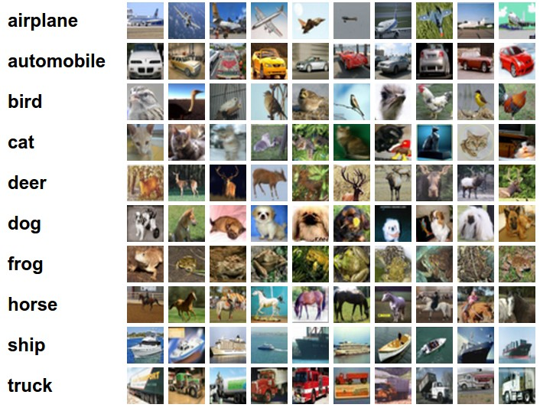
Example dataset: CIFAR-10
10 labels
50,000 training images
each image is 32x32x3
10,000 test images.

Slide 47
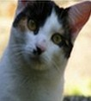
Parametric approach
image
parameters
f(x,W)
10 numbers, indicating class scores
[32x32x3]
array of numbers 0...1
(3072 numbers total)

Slide 48
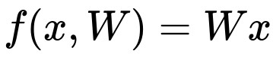
Parametric approach: Linear classifier
10 numbers, indicating class scores
[32x32x3]
array of numbers 0...1

Slide 49
Parametric approach: Linear classifier
3072x1
10x1
10x3072
10 numbers, indicating class scores
[32x32x3]
array of numbers 0...1
parameters, or “weights”

Slide 50
Parametric approach: Linear classifier
3072x1
(+b)
10x1
10x1
10x3072
10 numbers, indicating class scores
[32x32x3]
array of numbers 0...1
parameters, or “weights”

Slide 51
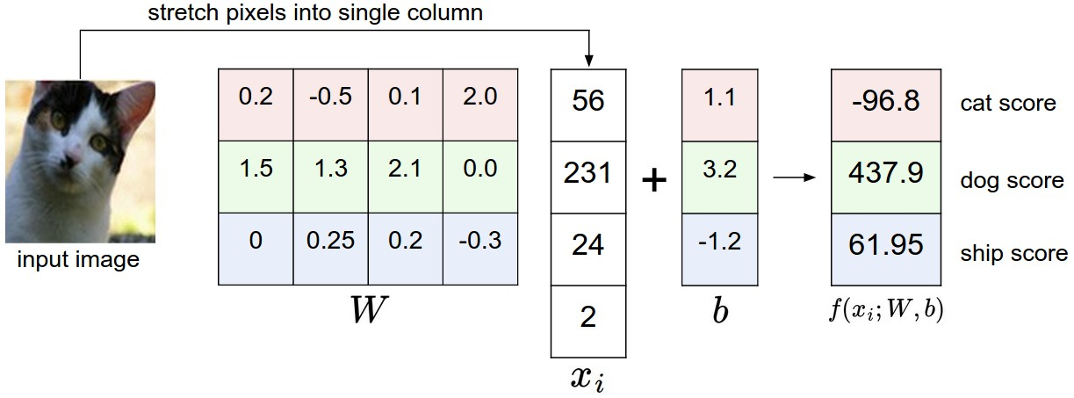
Example with an image with 4 pixels, and 3 classes (cat/dog/ship)

Slide 52
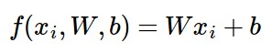
Interpreting a Linear Classifier
Q: what does the linear classifier do, in English?

Slide 53
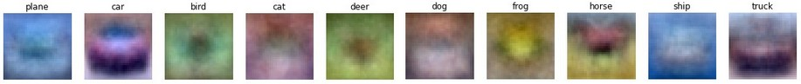
Interpreting a Linear Classifier
Example trained weights of a linear classifier trained on CIFAR-10:

Slide 54
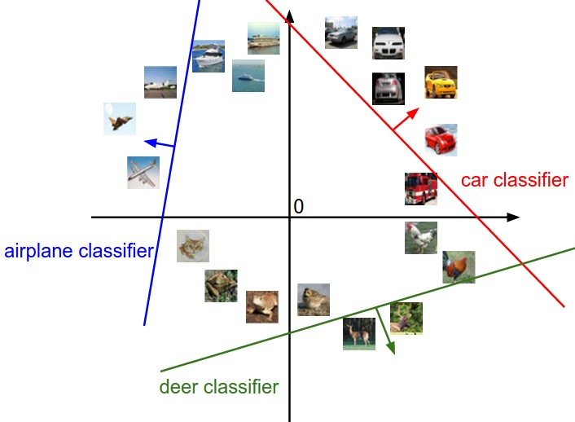
Interpreting a Linear Classifier
[32x32x3]
array of numbers 0...1
(3072 numbers total)

Slide 55
Interpreting a Linear Classifier
Q2: what would be a very hard set of classes for a linear classifier to distinguish?

Slide 56

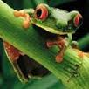
So far:
We defined a (linear) score function:
-3.45
-8.87
0.09
2.9
4.48
8.02
3.78
1.06
-0.36
-0.72
-0.51
6.04
5.31
-4.22
-4.19
3.58
4.49
-4.37
-2.09
-2.93
3.42
4.64
2.65
5.1
2.64
5.55
-4.34
-1.5
-4.79
6.14
Example class
scores for 3
images, with a
random W:

Slide 57
Coming up:
Loss function
Optimization
ConvNets!
(quantifying what it means to have a “good” W)
(start with random W and find a W that minimizes the loss)
(tweak the functional form of f)

